Slide 1
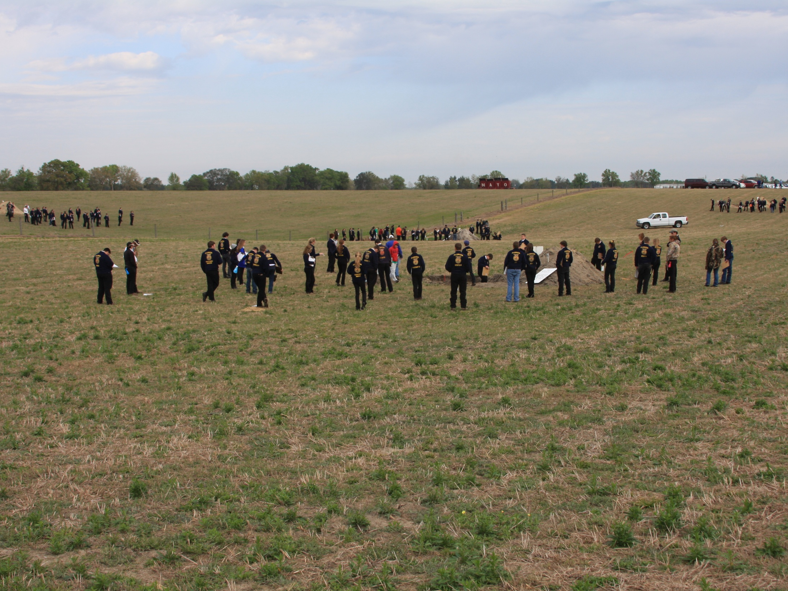
54th Annual Florida Land Judging Contest
Levy Soil and Water Conservation District
March 22, 2013

Slide 2
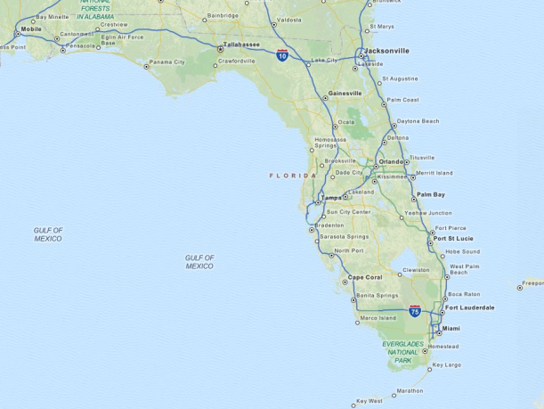
South on SR 24 to Bronson.
In Bronson, left on US 27 then right on CR 337 South.
3.7-3.8 miles south to 42nd St (not place). Left on 42nd street into property.
Pits on right past fence
2012 Contest Location (Bronson, FL)
4: Entisol
SHWT: >72”
Slope: 6.9%
2: Entisol (Ultisol)
SHWT: approx 25”
Slope: concave
3: Entisol
SHWT: >72”
Slope: 10.9%
1: Ultisol
SHWT: 19”
Slope: 1.5%

Slide 3
4: Entisol
SHWT: >72”
Slope: 6.9%
Excessive
Moderately Well
2: Entisol (Ultisol)
SHWT: approx 25”
Slope: concave
3: Entisol
SHWT: >72”
Slope: 10.9%
Somewhat
poor
Excessive
Poor
1: Ultisol
SHWT: 19”
Slope: 1.5%
Moderately Well
Field 2 notes: The argillic horizon occurs at a depth of around 60”. Since this was not exposed, the soil is assumed to be an Entisol. If we had dug the pit deeper, it would be classified as an Ultisol.

Slide 4
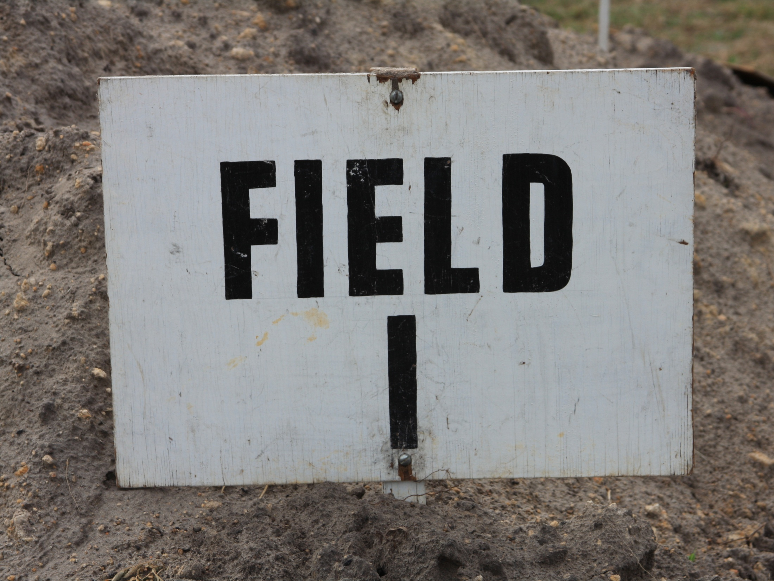

Slide 5
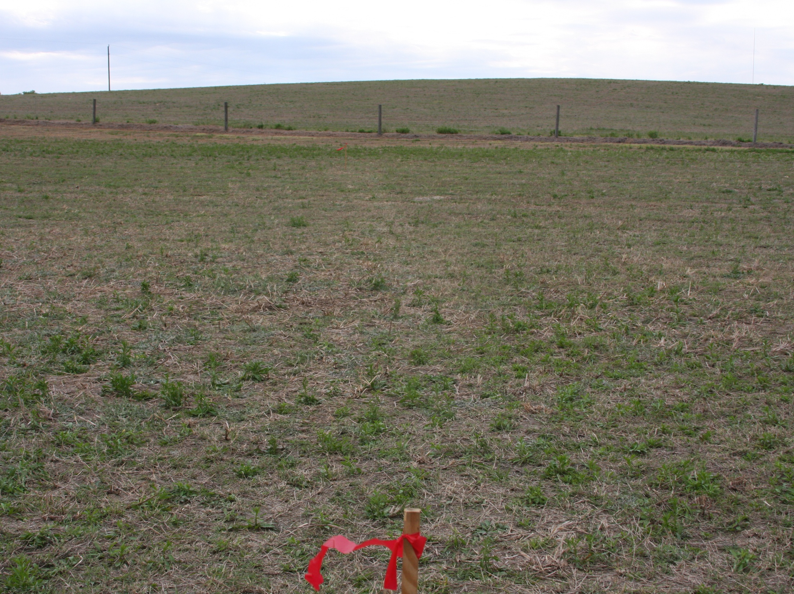
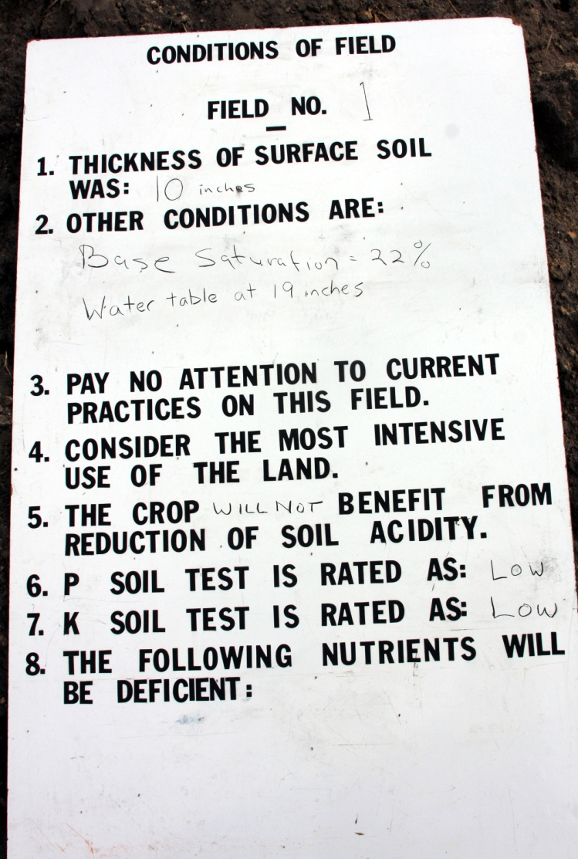
Topsoil Erosion:
10” original – 12” existing = 2” gained
12”/10” gained = 20% accumulated (low)
Rise = 1.5’
Slope = 1.5%
Run = 100’

Slide 6
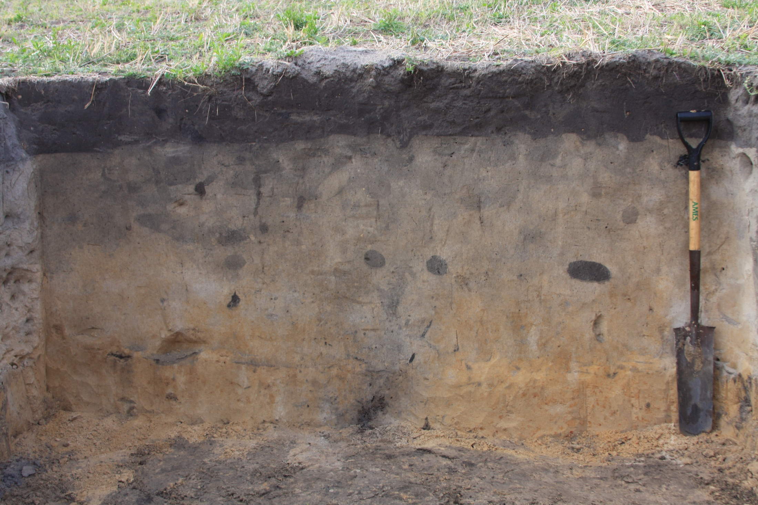
Field 1:

Slide 7
Field 1: Poorly drained Ultisol, 1.5% Slope Top soil = 10”
0-10” Ap Sand (10YR 3/2)
10-19” E1 Sand (10YR 5/2)
SHS: 19”
2% Redox Conc.
19-41” E2 Sand (10YR 6/2) 2-10% RC (7.5 YR 5/4)
41-55+” Btg Sand (10YR 7/3) 10% RC (5 YR 4/6)
20% RD (10YR 8/2)
Ultisol
Argillic horion, < 35% BS

Slide 8
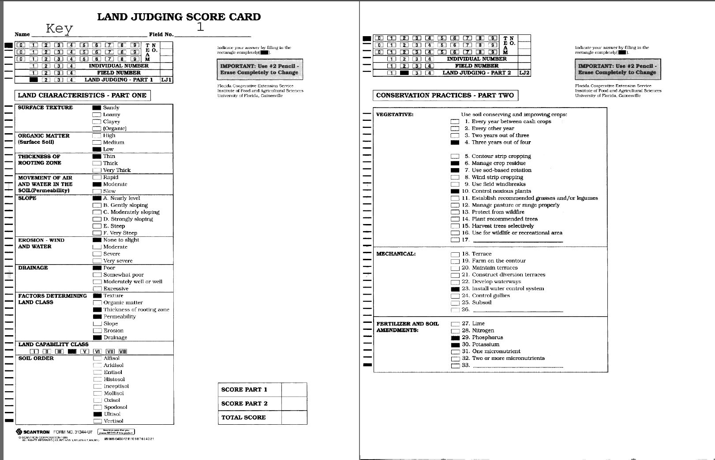

Slide 9
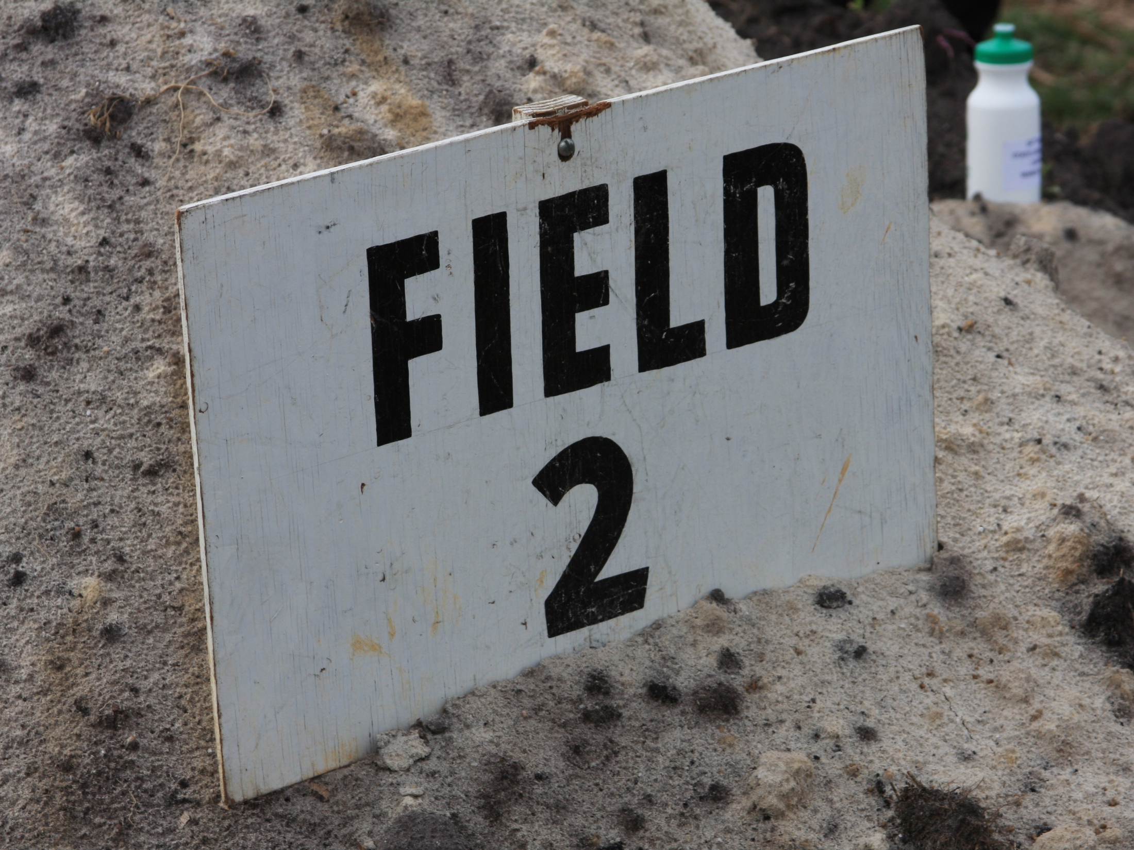

Slide 10
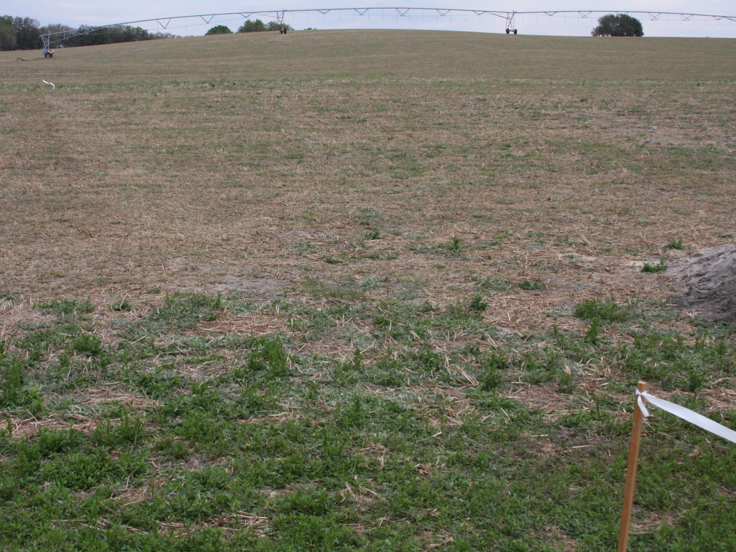
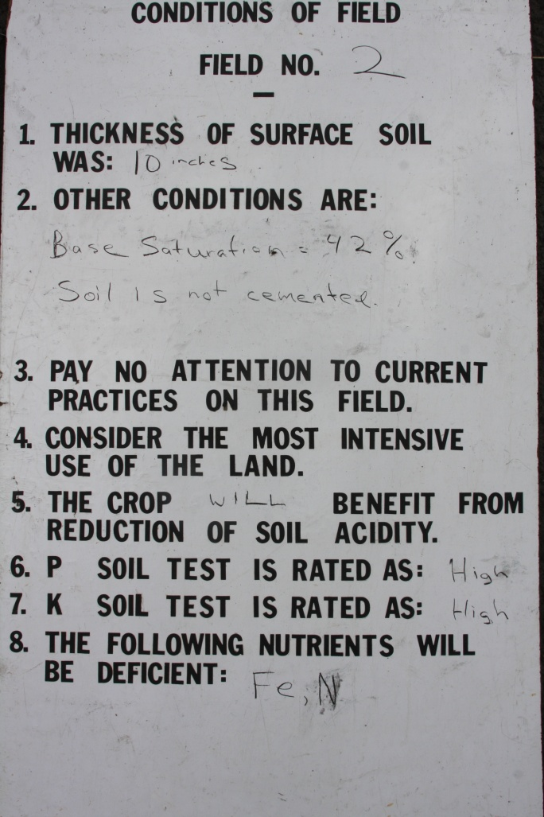
Topsoil Erosion:
10” original – 12” existing = 2” gained
12”/10” gained = 20% accumulated (low)
Run = 100’
Rise = 2.5’
Slope = 2.5%

Slide 11
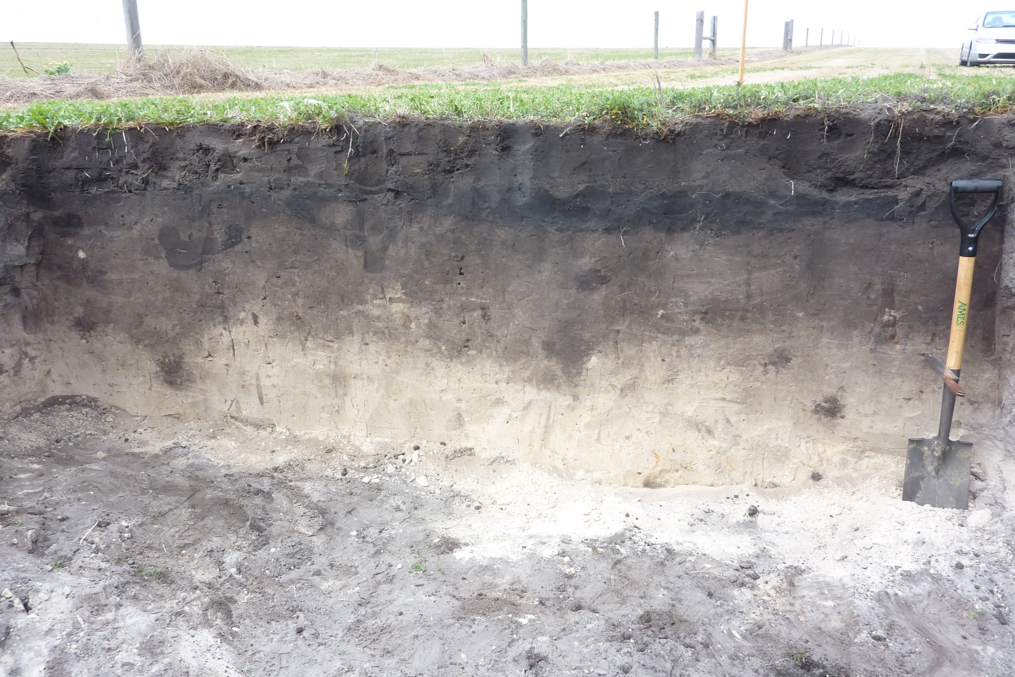
Field 2

Slide 12
Field 2: Poorly drained Inceptisol, 2.5% Slope Top soil = 12”
0-7” Ap1 Sand (10YR 2/1)
Umbric Epipedon:
>10” dark topsoil, < 50% BS
7-12” Ap2 Sand (N 2/0) Slightly compacted
12-25” AE Sand (10YR 4/2)
SHS: 25”
2% Redox Conc.
41-55+” E Sand (10YR 7/1) 2-10% RC (5YR 5/8)

Slide 13
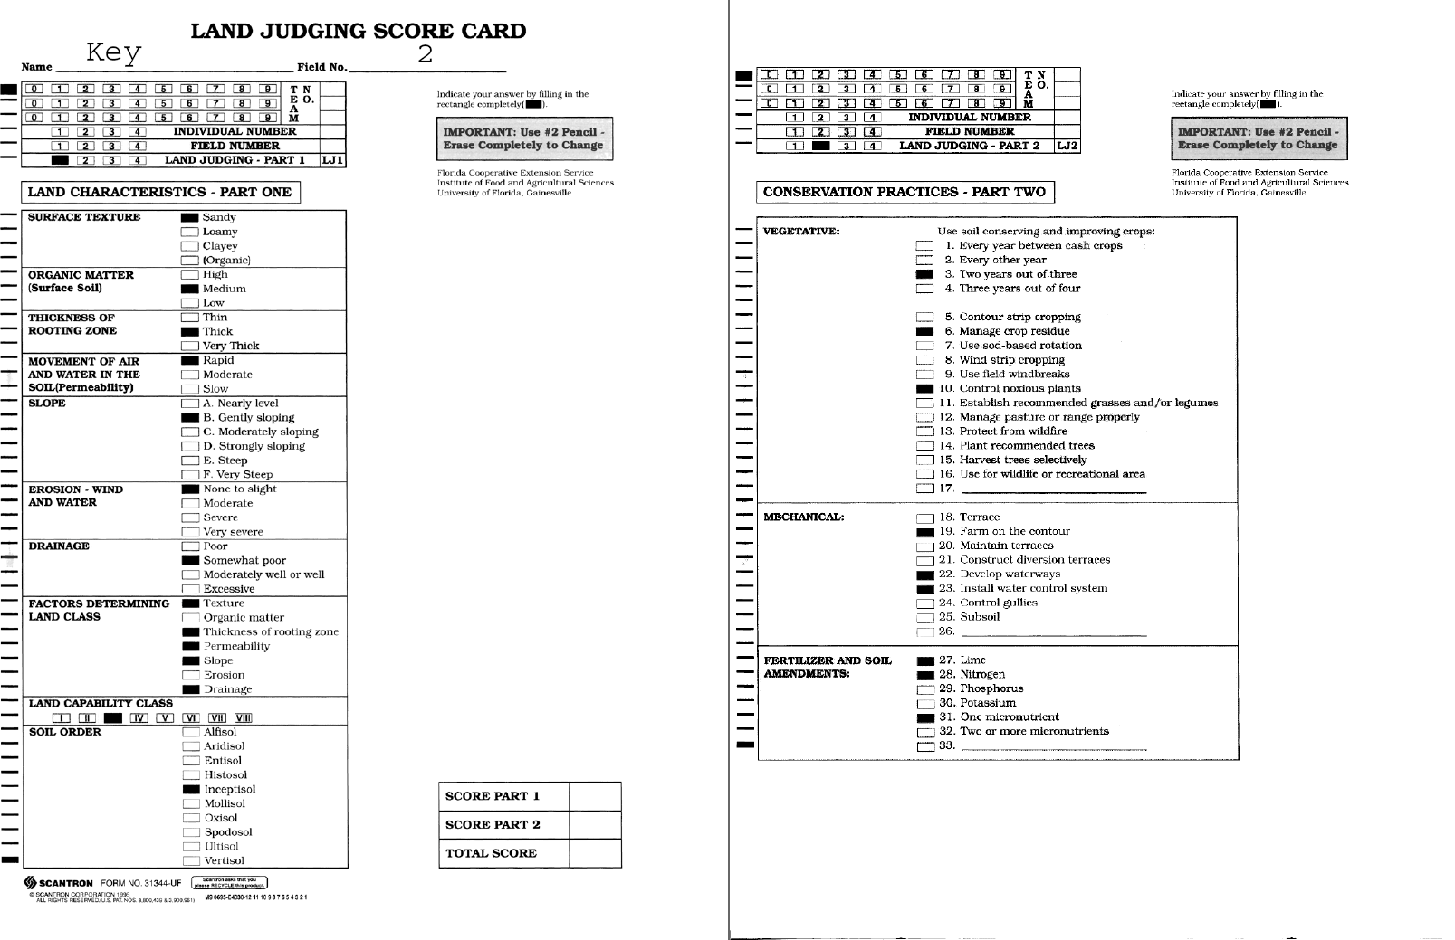

Slide 14
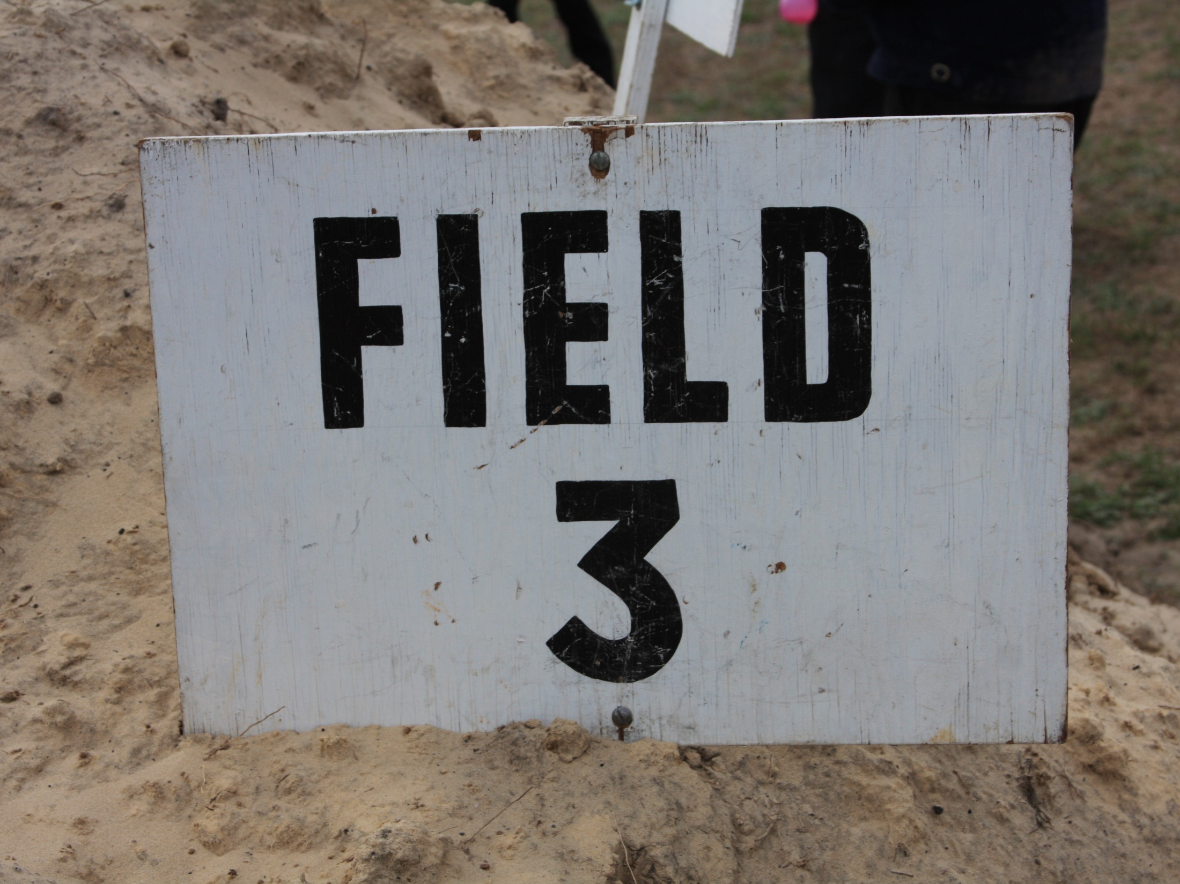

Slide 15
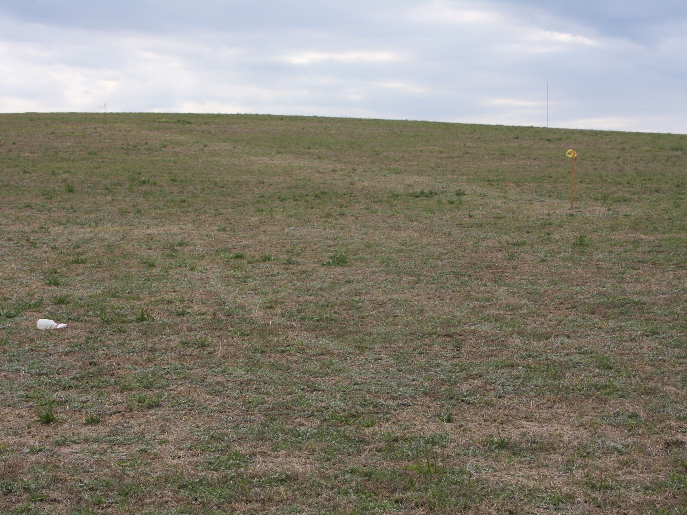
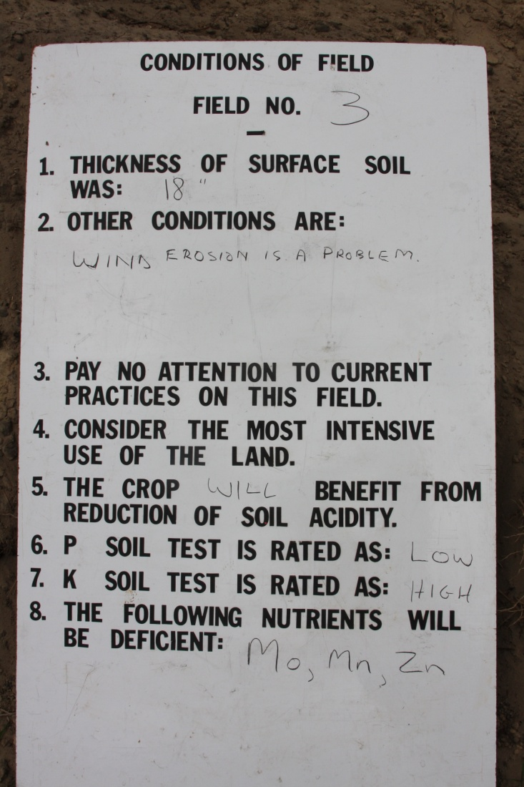
Run = 100’
Rise = 10.9’
Slope = 10.9%
Topsoil Erosion:
18” original – 12” existing = 6” lost
6”/18” lost = 33% erosion (moderate)

Slide 16
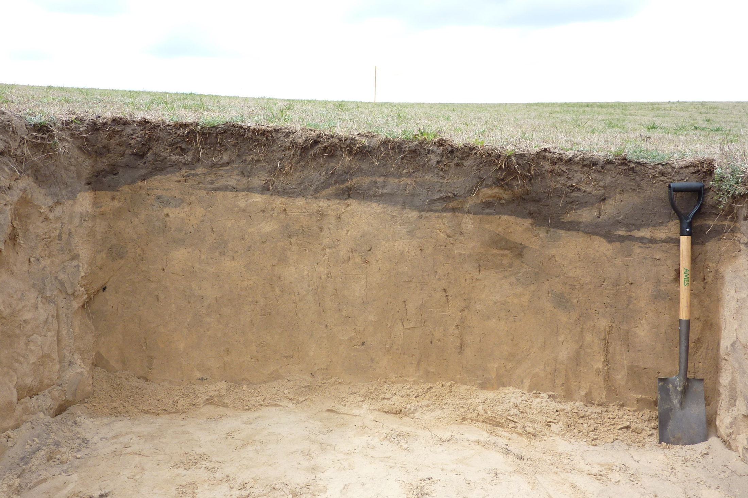
Field 3:

Slide 17
Field 3: Excessively drained Entisol, 10.9% Slope Top soil = 12”
0-12” Ap/E Sand (10YR 3/2) / Sand (10YR 5/6)
12-35” E1 Sand (10YR 5/6)
No observed SHWT features
35-42+” E2 Sand (10YR 6/6)

Slide 18
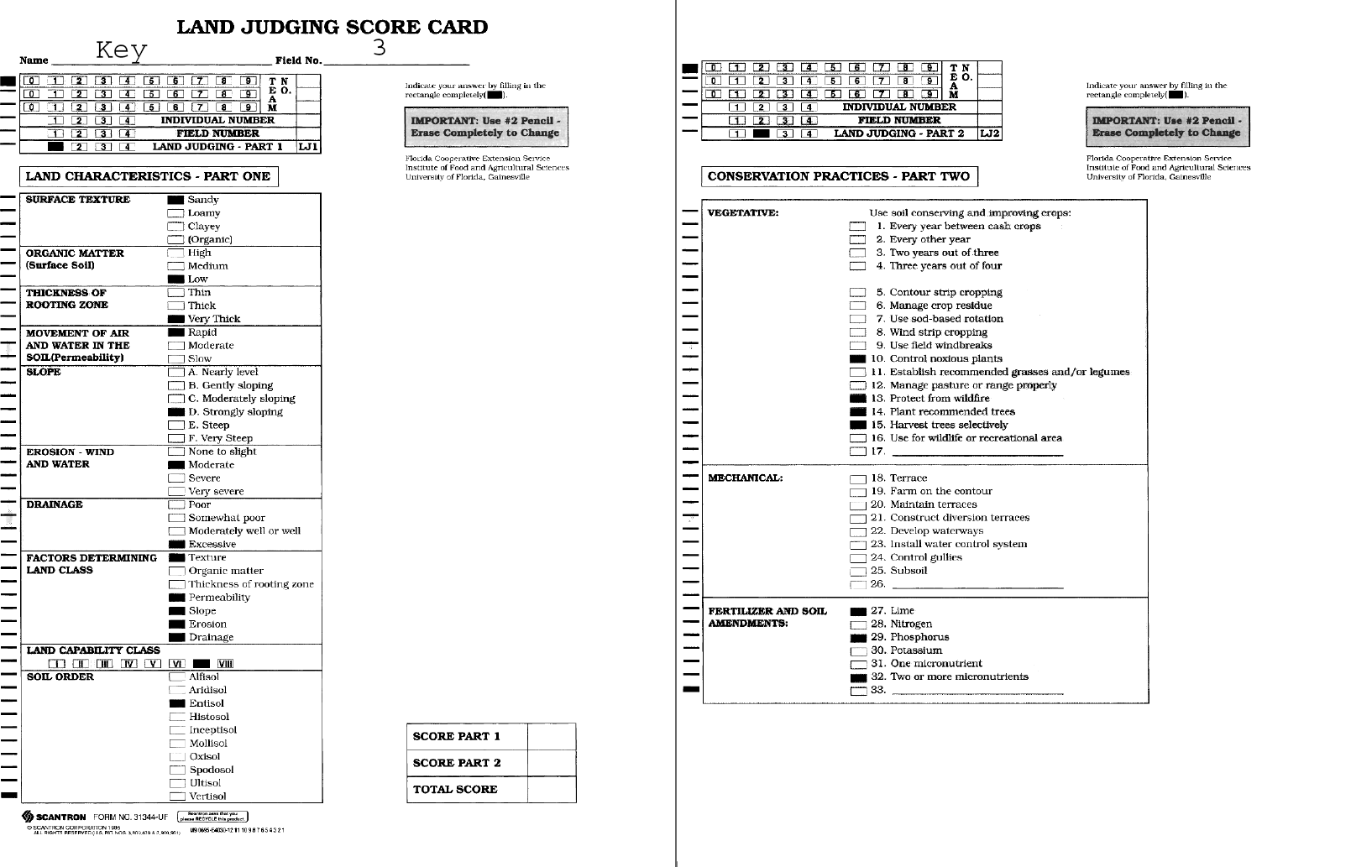

Slide 19
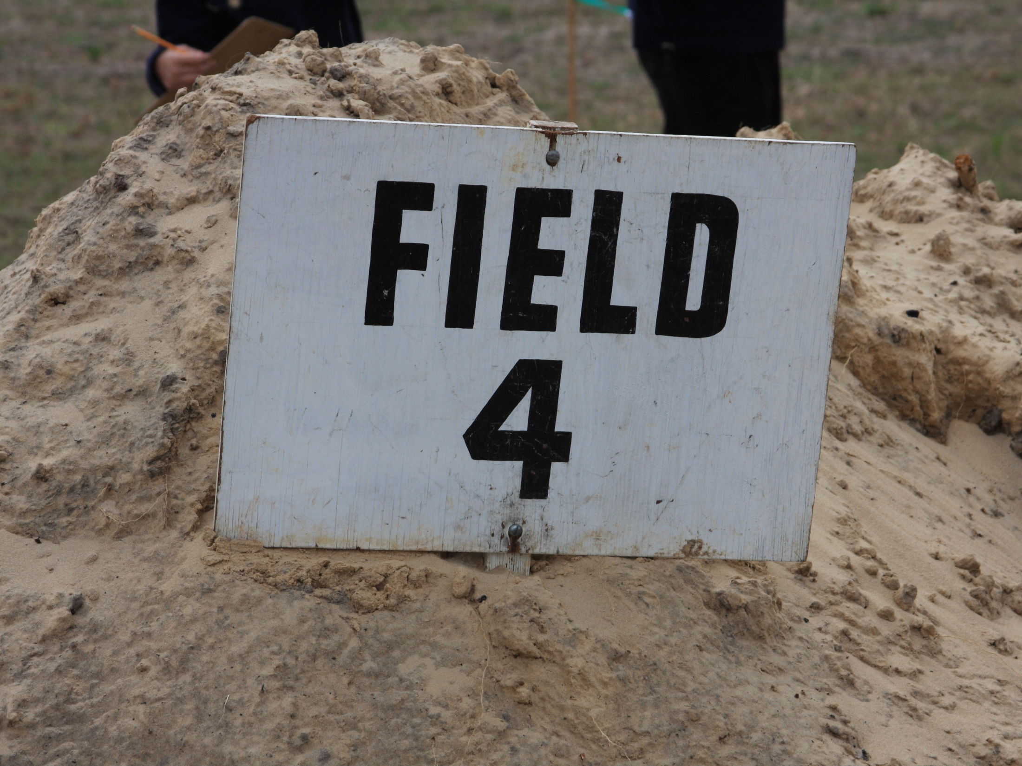

Slide 20
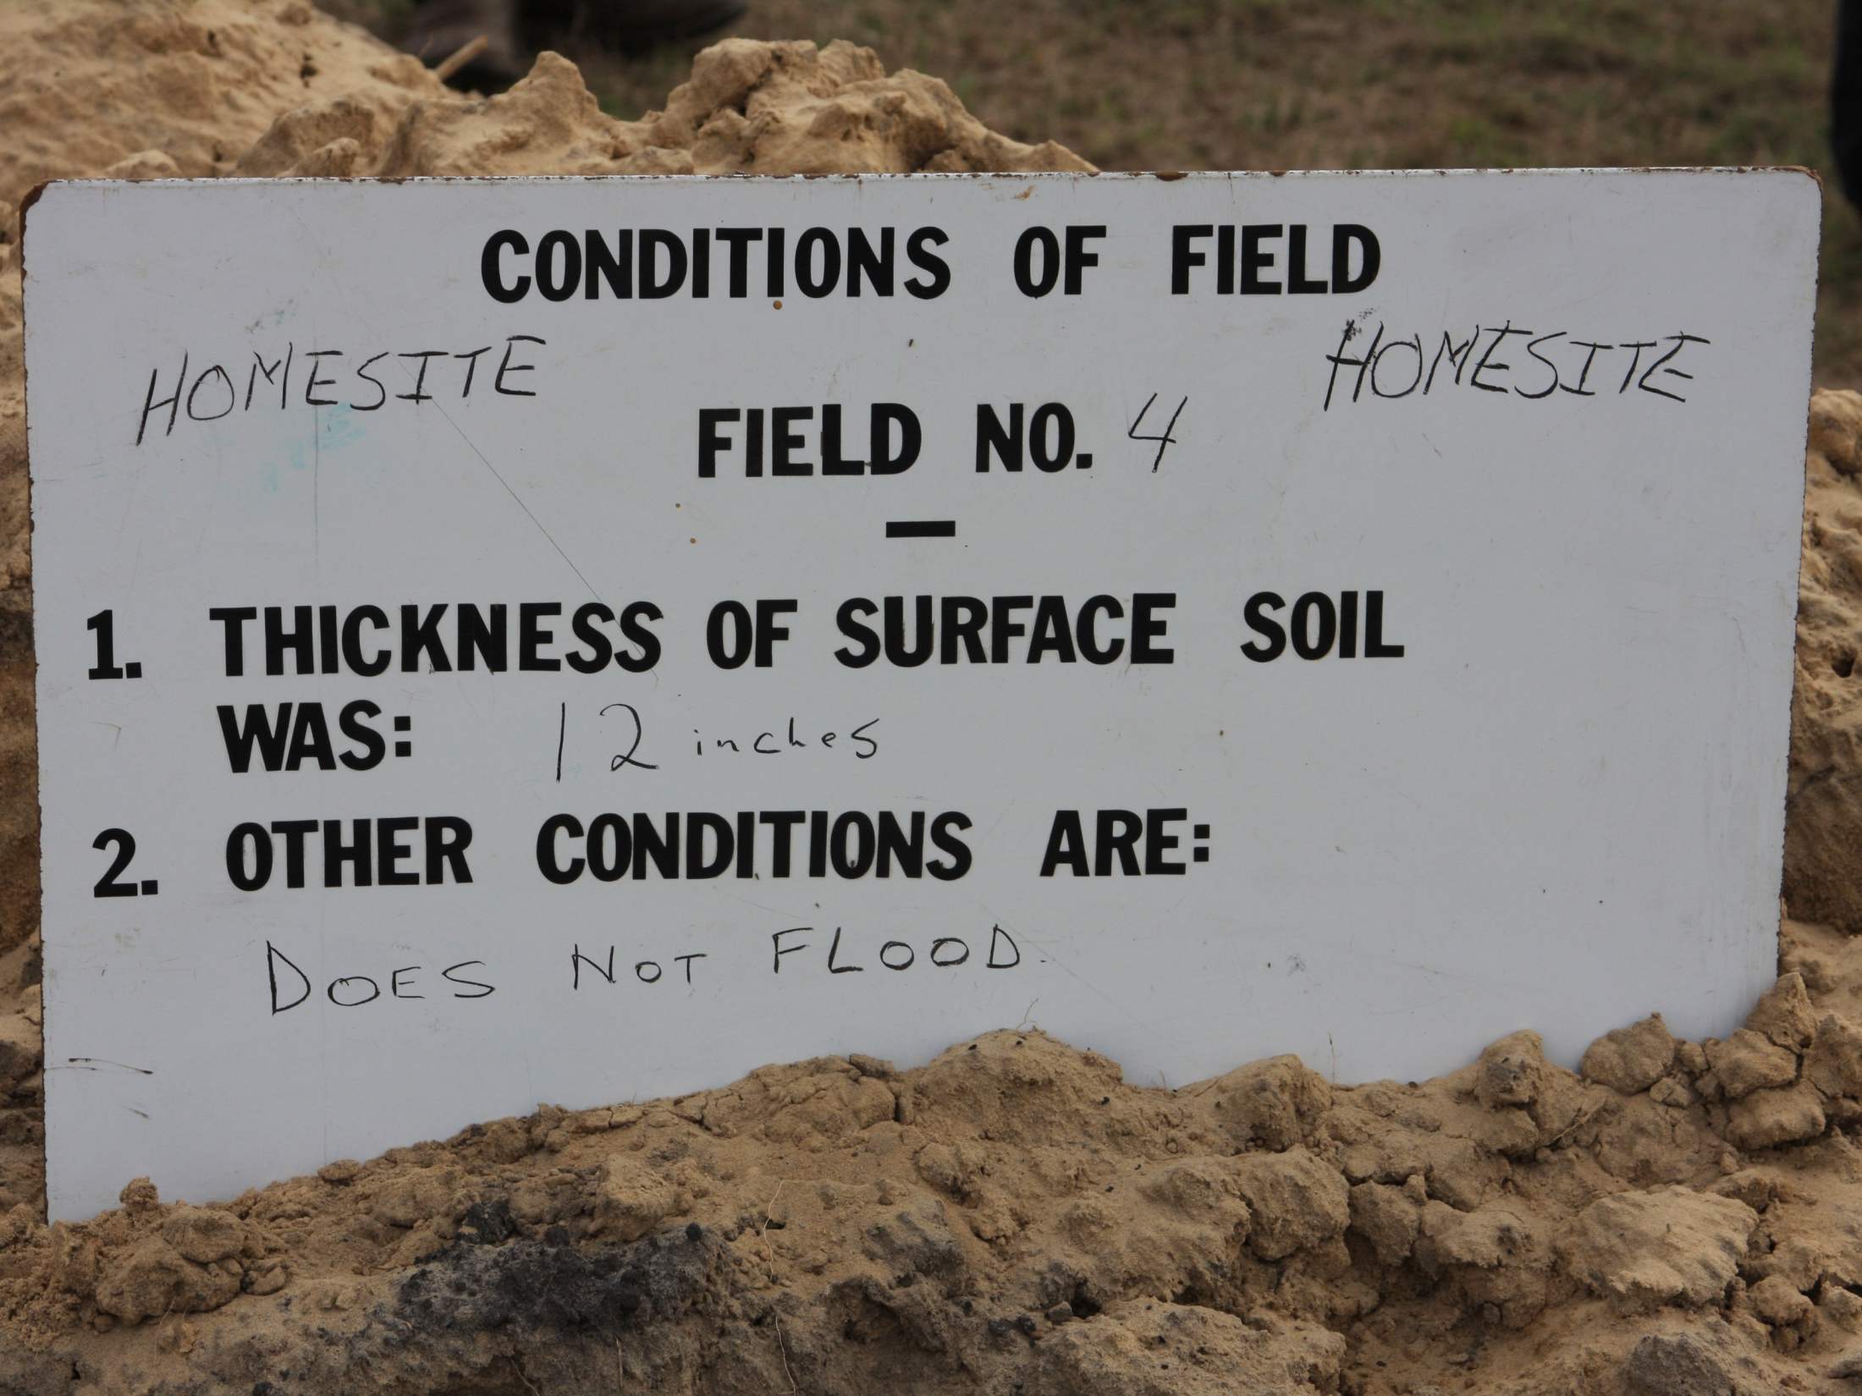

Slide 21
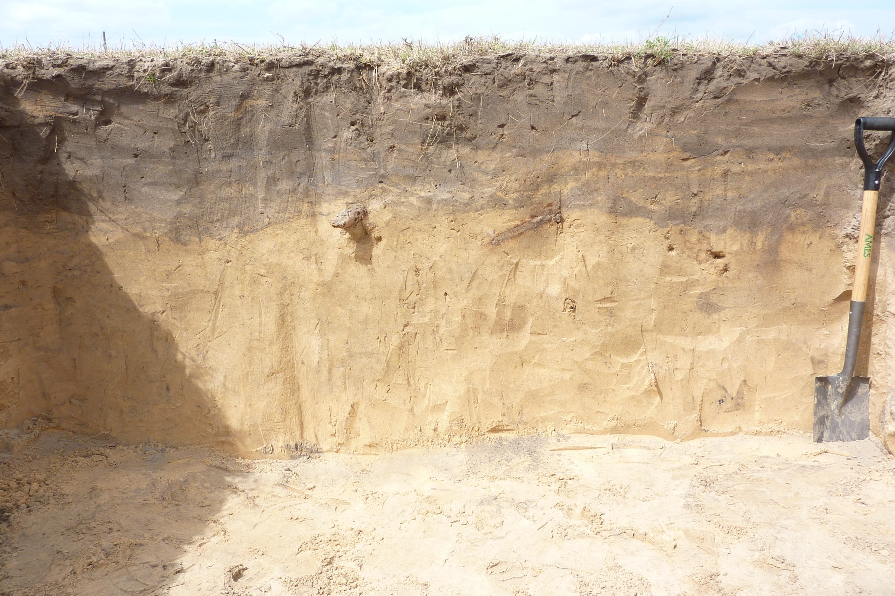
Homesite:

Slide 22
Homesite: Excessively drained Entisol, 6.9% Slope Top soil = 12”
0-12” Ap Sand (10YR 3/2)
12-35” Ap/E Sand (10YR 3/2) / Sand (10YR 5/6)
No observed SHWT features
35-42+” E2 Sand (10YR 6/6)

Slide 23
